Slide 1
The Restaurant Bubble
Utilizing Yelp API to understand restaurant closings in Los Angeles

Slide 2


Restaurant Industry Overview
14.7 million employees, or 10% of the U.S. workforce
1 million+ locations in the United States (~7% from California)
$799 billion in sales (~10% from California)
1.6 million new restaurant jobs created by the year 2027

Slide 3
Executive Summary
Overview
Margins for restaurants are slim. With rising labor costs and rent as well as market saturation, restauranteurs need to take a deeper dive into analytics to make smarter decisions regarding new ventures. The entrance of ‘disruptors’ in the industry (like DoorDash, UberEATs) will continue to threaten the industry.
Difficulty | Goal | Model
1 | Can Yelp parameters predict restaurant closings? | Decision Tree, Random Forest Classifier
3 | Can Yelp parameters predict the life of a restaurant? | TBD
2 | Is there a restaurant bubble in Los Angeles? | Random Forest Classifier by year
Data Acquisition
Refine
Identify
Mine
Model
Model
Tuning

Slide 4
Data Acquisition
A
LA County Data
Clean and extract necessary parameters of csv from Los Angeles County website
B
Yelp Search
Phone
Yelp claims their phone search will return the most accurate results through their Yelp Phone API
C
Yelp Search
Restaurant and Address
When a phone number is not provided, the restaurant name and location (address, zip, state) will be searched through Yelp Search API
D
Yelp Search
Business ID for Reviews
Once the correct business ID is obtained, the restaurant name will be searched by the Yelp unique business ID url, and the json will be parsed to return review information
Notes:
We are acquiring all of these parameters, but also need to make sure we gather whether the restaurant exists.
In A), we can use an outdated inspection as a proxy for a restaurant closure. Later, I was able to see that this proxy was correct about 80% of the time when compared with Yelp API.
In B & C, we’ll collect the data of ‘closed’ from Yelp, which will return True or False.

Slide 5
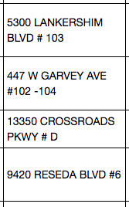
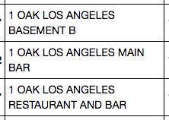
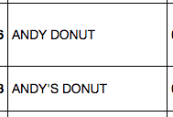
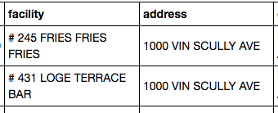
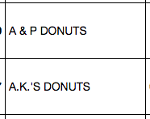
LA County Data Issues
A
Suite or Store Number
Multiple Inspections
Issue: A pound sign will throw off our ‘best match’ Yelp results when we use their API
Solution: Regex
Issue: Multiple inspections for one restaurant
Solution: groupbys, comprehensive dictionaries
Misspellings
Non-restaurant Inspections
Issue: Is it a misspelling, or a different restaurant? How can we accurately aggregate?
Solution: Partial solve with Regex, but room for error
Issue: Entertainment/sporting venues, airports, colleges, grocery stores, etc. all require inspections
Solution: comprehensive dictionaries
Notes:
The more I can shrink and group this list, the less API calls I have to make, and the more accuracy I’ll receive when I search and assess my accuracy against my corpus.

Slide 6
Yelp Search - Phone and Term/Location
B, C
Desired Data
business_id
name
price ($ - $$$$)
category_1
category_2
closed
address
city, zip
longitude, latitude
Process
yp.create_searches
yp.yelp_api_calls
yp.find_failed_searches
yp.format_srch_dict
yp.pick_correct_matches
Tracker
{'Total DataFrame': (9094, '100%'),
'Restaurants with Phone Provided': (4613, '51.0%'),
'Successful Matches from Phone Searches': (2350, '26.0%'),
'Remaining Restaurants to Search with Term/Location': (6737, '74.0%'),
'Restaurants with Successful Term/Location Searches': (5861, '64.0%'),
'Successful Matches from Term/Loc Searches': (1183, '13.0%'),
'Successful Matches all Searches': (3533, '39.0%')}

Slide 7
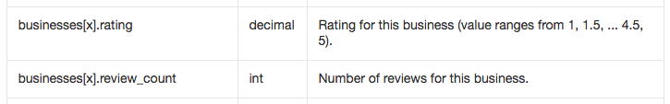
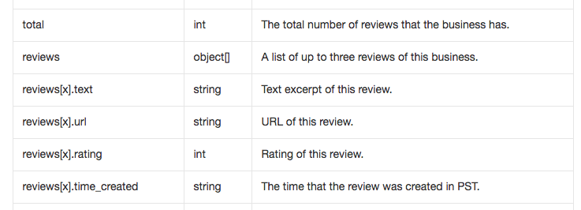
Yelp Search - Business ID
D
Desired Data
avg_rating
review_count
review_date
ROADBLOCK
Yelp Search API returns two things that will be crucial to have as a feature:
Yelp Reviews API returns just THREE reviews for a business_id search
Notes:
Can we do better on the average rating and get a continuous number?
How can we get more than three reviews, and make sure that the first and last are collected to give us a proxy for the life of the restaurant?
Using the actual business ID in the url, I found out I could ‘sort’ the reviews fairly easily.
Keep in mind this isn’t technically using the Yelp API for its intended purpose. Are we going to have trouble with Yelp allowing us to make so many get requests at once?

Slide 8
Yelp Search - Business ID - Initial Solution
D
Jupyter
Mongo
Docker
Docker
Ubuntu
Ubuntu
Volume
AWS
AWS

Slide 9
Yelp Search - Business ID - Final Solution
D
iterate through list of business_id obtained from Yelp phone, term/location searches
encode and quote the business_id
establish review url with business_id, sorted by the oldest reviews first
try a get request to Yelp for the review URL
get request fails
get request succeeds
30 second sleep
find the embedded json object using indexes and split
append the rating_cnt, rating_val, author, datePublished, ratingValue
establish review url with business_id, sorted by the newest reviews first

Slide 10
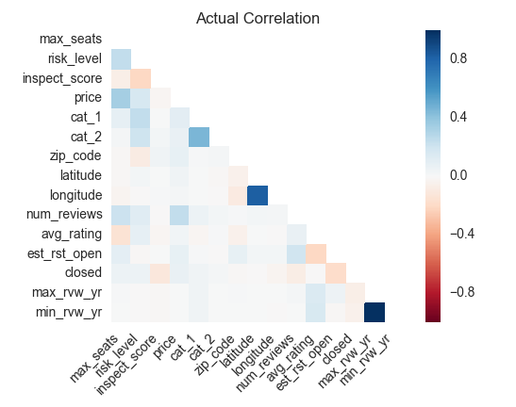
Data Mining

Slide 11
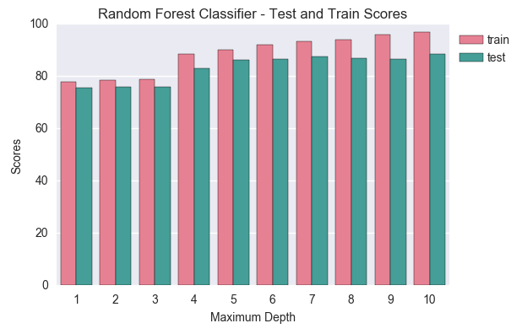
Model

Slide 12
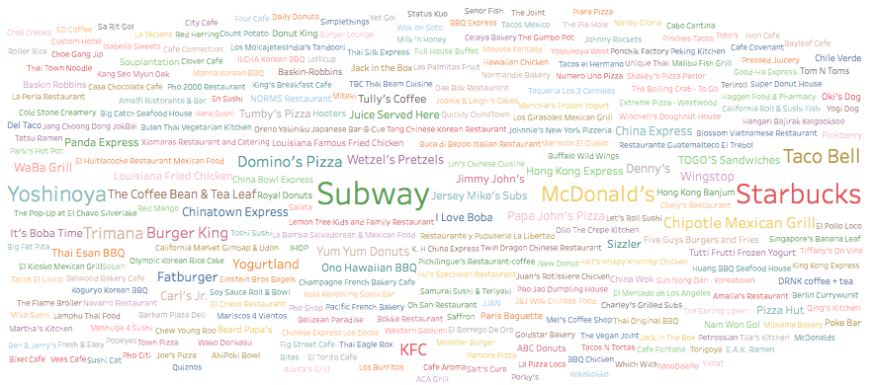
Future Aspirations – Easy

Slide 13
Future Aspirations – Easy

Slide 14
Future Aspirations – More Difficult
Work with current data to return accurate Yelp searches
Increase scope
Characterize neighborhoods (Koreatown, Little Ethiopia, Little Tokyo)

